Slide 1

INSTITUTE UIE
DEPARTMENT ACADEMIC UNIT-1
Bachelor of Engineering (Computer Science & Engineering)
Subject Name Introduction Electrical & Electronics Engineering
Subject Code 23ECH-101
Prepared By
Dr. Shikha
Unit-2 Chapter-2
DeMultiplexer
Lecture No. 2.1.5
De-Mux, Encoder & Decoder
DISCOVER . LEARN . EMPOWER

Slide 2

Lecture Objectives
S. No. | Objectives
1 | To make student aware about the derivation of logic for the design of Demultiplexer.
2 | To aware about implementation of Demultiplexer circuit.
3 | To learn about design of different design of Demuktiplexer.

Slide 3
Course Objectives
S. No. | Objectives
1 | Understand Electrical & Electronics Engineering Fundamentals
2 | To prepare students to perform the analysis and design of various Electrical & digital electronic circuits.

Slide 4
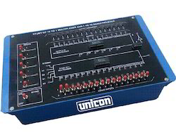
Course Outcome
CO Number | Title | Level
CO1 | To identify the different types of electrical elements and the basic op-amp circuit elements and to illustrate the various types of motors, transducers. | Remember
CO2 | To understand basic principles of transformers, transducers, op-amps, DC and AC motors and to compare the different methods for analysing electrical and magnetic circuits. | Understand
CO3 | To derive the relationships between parameters in electric and magnetic circuits and motors and to determine specifications of op-amps. | Analyze
CO4 | To solve the basic problems related to electric circuits, magnetic circuits and motors and to assess the characteristics of different configurations of op-amps. | Evaluate
CO5 | To design the different applications of transducers, motors as well as the op-amps like adders, subtractor and comparators. | Create
DeMULTIPLEXER

Slide 5
Contents
What is Demultiplexer.
Demux Types.
1-to-2 Line Demultiplexer.
1-to-4 Line Demultiplexer.
1-to-8 Line Demultiplexer.
1-to-8 Line Demultiplexer Truth Table.

Slide 6
What is De-Multiplexer?
A DEMUX is a digital switch with a single input (source) and a multiple outputs (destinations).The select lines determine which output the input is connected to.
DEMUX TYPES
1-to-2 (1 select line)
1-to-4 (2 select lines)
1-to-8 (3 select lines)
1-to-16 (4 select lines)

Slide 7
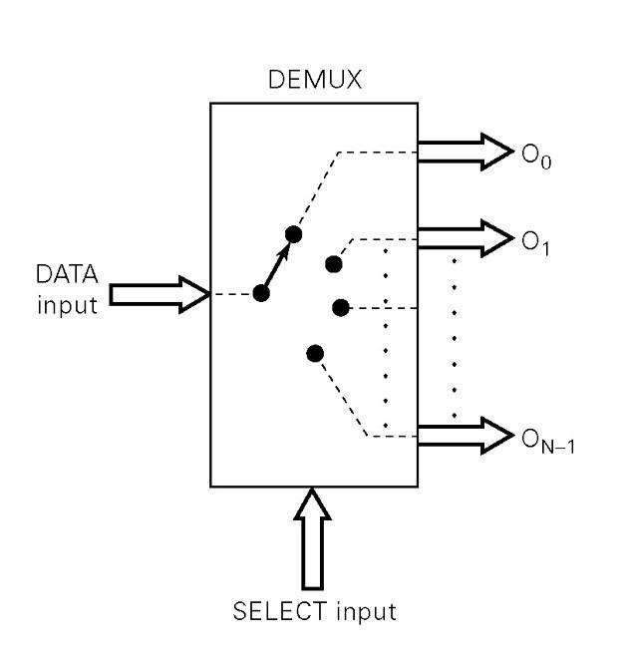
Functional Diagram Of a Demultiplexer
Fig 1: Functional Diagram Of a De-multiplexer

Slide 8
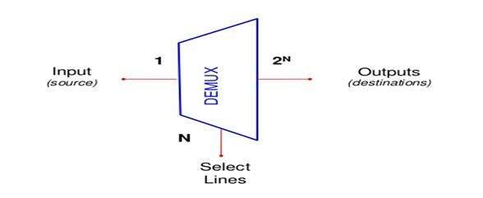
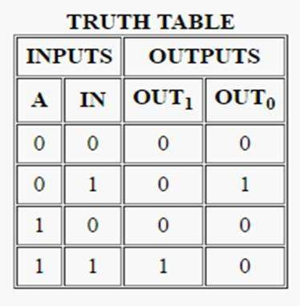
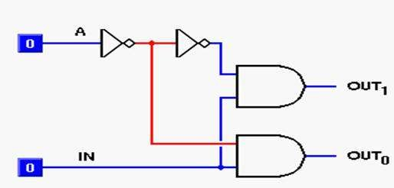
Demultiplexer
1 to 2 line De-Multiplexer
Fig 2 1 to 2 line De-multiplexer

Slide 9
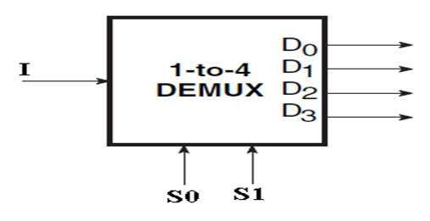
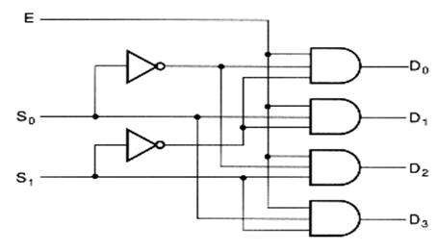
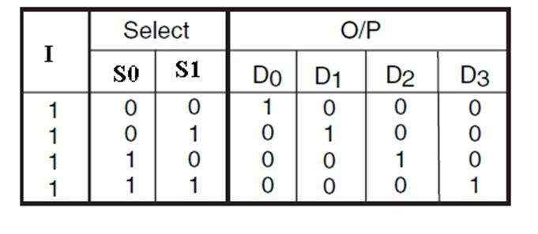
1- to- 4 line demultiplexer
Fig 3: 1 to 4 line De-multiplexer

Slide 10
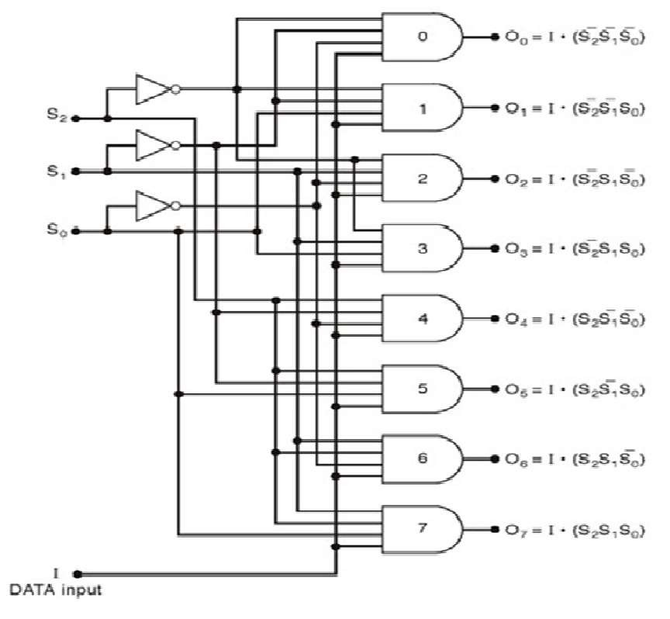
1 : 8 Demultiplexer
Fig 4: 1 to 4 line De-multiplexer

Slide 11
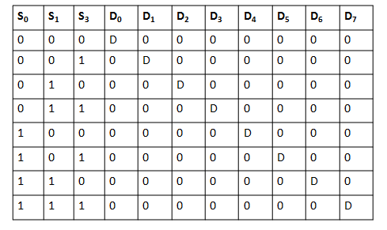
1 : 8 Demultiplexer (Truth Table)
Fig 5: 1 to 4 line De-multiplexer

Slide 12
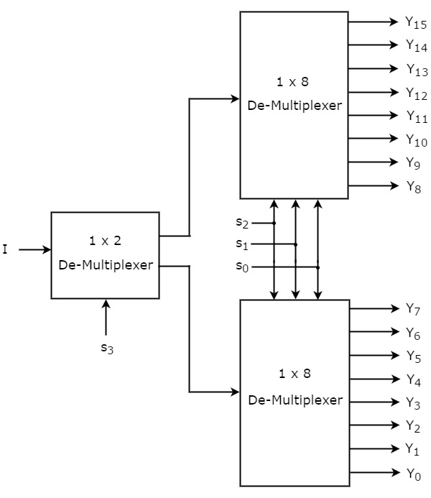
De–Mux Tree

Slide 13
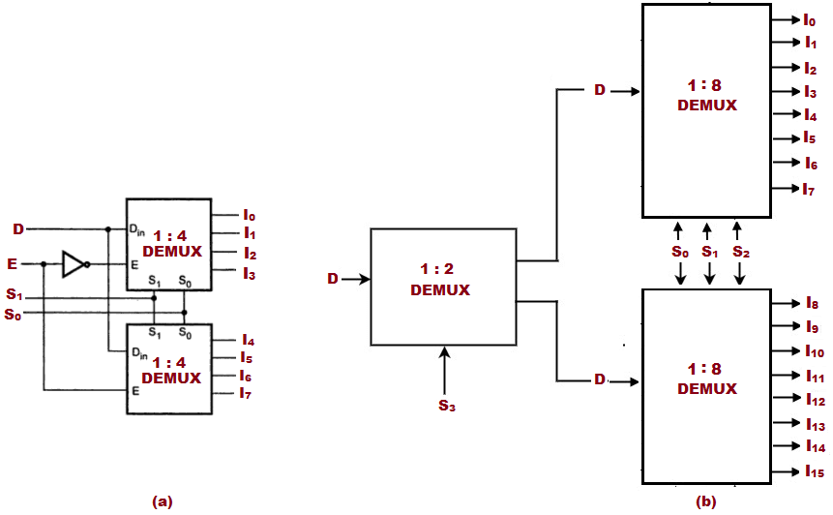

Slide 14
ENCODER
An Encoder is a combinational logic circuit.
It performs the inverse operation of Decoder.
The opposite process of decoding is known as Encoding.
An Encoder converts an active input signal into a coded output signal.
Block diagram of Encoder is shown in Fig.1.1. It has ‘M’ inputs and ‘N’ outputs.
An Encoder has ‘M’ input lines, only one of which is activated at a given time, and produces an N-bit output code, depending on which input is activated.
A₀ A₁
A₂
Encoder
B₀ B₁
B₂
Inputs
‘N’ Outputs
‘M’
- - - - - - -
- - - - - - -
^{A}M-1
^{B}N-1
Fig. 6: - ENCODER DIAGRAM

Slide 15
Encoders are used to translate the rotary or linear motion into a digital signal.
The difference between Decoder and Encoder is that Decoder has Binary Code as an input while Encoder has Binary Code as an output.
Encoder is an Electronics device that converts the analog signal to digital signal such as BCD Code.
Types of Encoders
Priority Encoder
Decimal to BCD Encoder
Octal to Binary Encoder
Hexadecimal to Binary Encoder

Slide 16


ENCODER
M=4 M=2² M=2^{N}
‘M’ is the input and ‘N’ is the output
A₀ A₁ A₂
A₃
B₀
B
1
Encoder 4 x 2
Decoder 2 x 4
B₂ B₃
Fig. 7: ENCODER DIAGRAM

Slide 17


ENCODER
M=4 M=2² M=2^{N}
‘M’ is the input and ‘N’ is the output
A₀ A₁ A₂ A₃
00
01
10
11
Encoder 4 x 2
Decoder 2 x 4
Fig. 8 ENCODER DIAGRAM

Slide 18
ENCODER
M=4 M=2² M=2^{N}
‘M’ is the input and ‘N’ is the output
A₀ A
00
01
10
11
1
1
Encoder 4 x 2
Decoder 2 x 4
A₂ A₃
0
Fig. 9: ENCODER DIAGRAM

Slide 19
ENCODER
M=4 M=2² M=2^{N}
‘M’ is the input and ‘N’ is the output
A₀ A
00
01
10
11
1
1
Encoder 4 x 2
Decoder 2 x 4
A₂ A₃
0
10
Fig. 10: ENCODER DIAGRAM

Slide 20







PRIORITY ENCODER
As the name indicates, the priority is given to inputs line.
If two or more input lines are high at the same time i.e 1 at the same time, then the input line with high priority shall be considered.
Block diagram and Truth table of Priority Encoder are shown in fig. 1.6.
Highest Priority
Input
TRUTH TABLE:
D₃
D₂
INPUTS |  |  |  | OUTPUTS |  | V
D₃ | D₂ | D₁ | D₀ | Y₁ | Y₀
0 | 0 | 0 | 0 | x | x | 0
0 | 0 | 0 | 1 | 0 | 0 | 1
0 | 0 | 1 | x | 0 | 1 | 1
0 | 1 | x | x | 1 | 0 | 1
1 | x | x | x | 1 | 1 | 1
Y₁
Priority Encoder
D₁
D₀
Y₀
Lowest Priority Output
Input
Block Diagram of Priority Encoder
Fig. 1 1 : ENCODER DIAGRAM

Slide 21
There are four inputs D₀, D₁,D₂, D₃ and two outputs Y₁ and Y_{2.}
D₃ has highest priority and D₀ is at lowest priority.
If D₃=1 irrespective of other inputs then output Y₁Y₀=11.
D₃ is at highest priority so other inputs are considered as don’t care.
K-map for Y₁ and Y₀
D₁D₀
00 01 11 10
D₁D₀
D₃D₂
D₃D₂
00 01 11 10
X |  | 0 | 0 | 0
 | 1 | 1 | 1 | 1
 | 1 | 1 | 1 | 1
1 |  | 1 | 1 | 1
 | X | 0 | 1 | 1
 | 0 | 0 | 0 | 0
 | 1 | 1 | 1 | 1
 | 1 | 1 | 1 | 1
00
00
01
01
11
11
10
10
Y₁ = D₂ + D₃
Y = D + D D
0
3
2 1
Fig. 12 : ENCODER DIAGRAM

Slide 22
LOGIC DIAGRAM OF PRIORITY ENCODER:
Y₁ = D₂ + D₃
Y₀ = D₂ D₁ + D₃
D₃ D₂ D₁ D₀
Y₁
Y₀
Fig. 13 : ENCODER DIAGRAM

Slide 23

DECIMAL TO BCD ENCODER:
It has ten inputs corresponding to ten decimal digits (from 0 to 9) and four outputs (A,B,C,D) representing the BCD.
0
1
2
A
B
- - - - - - - - -
ENCODER
C
9
INPUTS
D
OUTPUTS
Fig. 14 : ENCODER DIAGRAM

Slide 24
Truth Table
INPUTS |  |  |  |  |  |  |  |  |  | BCD OUTPUTS
0 | 1 | 2 | 3 | 4 | 5 | 6 | 7 | 8 | 9 | A | B | C | D
1 | 0 | 0 | 0 | 0 | 0 | 0 | 0 | 0 | 0 | 0 | 0 | 0 | 0
0 | 1 | 0 | 0 | 0 | 0 | 0 | 0 | 0 | 0 | 0 | 0 | 0 | 1
0 | 0 | 1 | 0 | 0 | 0 | 0 | 0 | 0 | 0 | 0 | 0 | 1 | 0
0 | 0 | 0 | 1 | 0 | 0 | 0 | 0 | 0 | 0 | 0 | 0 | 1 | 1
0 | 0 | 0 | 0 | 1 | 0 | 0 | 0 | 0 | 0 | 0 | 1 | 0 | 0
0 | 0 | 0 | 0 | 0 | 1 | 0 | 0 | 0 | 0 | 0 | 1 | 0 | 1
0 | 0 | 0 | 0 | 0 | 0 | 1 | 0 | 0 | 0 | 0 | 1 | 1 | 0
0 | 0 | 0 | 0 | 0 | 0 | 0 | 1 | 0 | 0 | 0 | 1 | 1 | 1
0 | 0 | 0 | 0 | 0 | 0 | 0 | 0 | 1 | 0 | 1 | 0 | 0 | 0
0 | 0 | 0 | 0 | 0 | 0 | 0 | 0 | 0 | 1 | 1 | 0 | 0 | 1
Fig. 15 : ENCODER DIAGRAM

Slide 25
From Truth Table it is clear that the output A is HIGH when input is 8 OR 9 is HIGH
Therefore A=8+9
The output B is HIGH when 4 OR 5 OR 6 OR 7 is HIGH Therefore B=4+5+6+7
The output C is HIGH when 2 OR 3 OR 6 OR 7 is HIGH
Therefore C=2+3+6+7
Similarly D=1+3+5+7+9
Logic Diagram is shown in fig. 1.11

Slide 26
DECIMAL TO BCD ENCODER
+5V
0
1
2
3
4
5
6
7
8
9
A
B
C
D
Fig. 16: ENCODER DIAGRAM

Slide 27

OCTAL TO BINARY ENCODER
Block Diagram of Octal to Binary Encoder is shown below.
It has eight inputs and three outputs.
Only one input has one value at any given time.
Each input corresponds to each octal digit and output
corresponding Binary Code.
generates
D₀ D₁ D₂ D₃ D₄ D₅ D₆ D₇
X
ENCODER
Y
Z
INPUT
OUTPUT
Fig. 17: ENCODER DIAGRAM

Slide 28
TRUTH TABLE
INPUT |  |  |  |  |  |  |  | OUTPUT
D₀ | D₁ | D₂ | D₃ | D₄ | D₅ | D₆ | D₇ | X | Y | Z
1 | 0 | 0 | 0 | 0 | 0 | 0 | 0 | 0 | 0 | 0
0 | 1 | 0 | 0 | 0 | 0 | 0 | 0 | 0 | 0 | 1
0 | 0 | 1 | 0 | 0 | 0 | 0 | 0 | 0 | 1 | 0
0 | 0 | 0 | 1 | 0 | 0 | 0 | 0 | 0 | 1 | 1
0 | 0 | 0 | 0 | 1 | 0 | 0 | 0 | 1 | 0 | 0
0 | 0 | 0 | 0 | 0 | 1 | 0 | 0 | 1 | 0 | 1
0 | 0 | 0 | 0 | 0 | 0 | 1 | 0 | 1 | 1 | 0
0 | 0 | 0 | 0 | 0 | 0 | 0 | 1 | 1 | 1 | 1
Fig. 18 : ENCODER DIAGRAM

Slide 29
X = D₄ + D₅ + D₆ + D₇ Y = D₂ + D₃ + D₆ + D₇ Z = D₁ + D₃ + D₅ + D₇
LOGIC DIAGRAM
D₀ D₁ D₂ D₃
D₄ D₅
D₆
D₇
X = D₄ + D₅ + D₆ + D₇
Y = D₂ + D₃ + D₆ + D₇
Z = D₁ + D₃ + D₅ + D₇
Fig. 19: ENCODER DIAGRAM

Slide 30
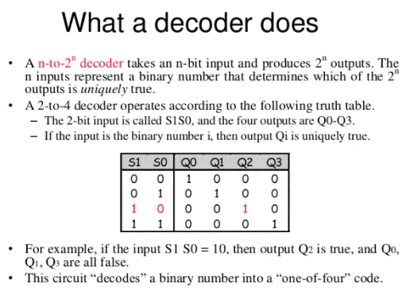
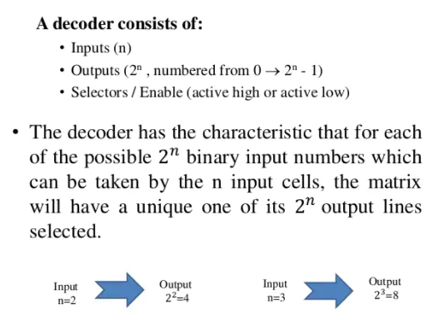
Decoder

Slide 31
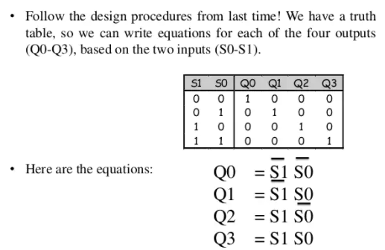
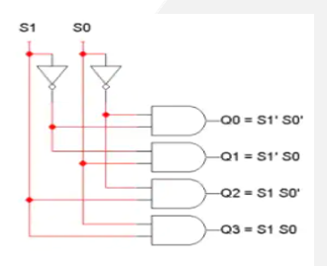
Design of 2-to-4 Decoder

Slide 32
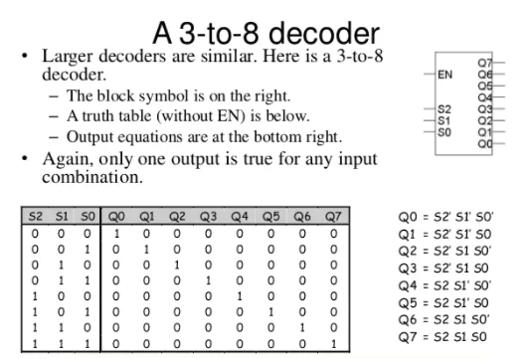

Slide 33
Questions:
1. Implement the following function using 3:8 decoder.
Y0(A,B,C)=(0,1,2,4)
Y1(A,B,C)=(1,3,5,7)
Y2(A,B,C)=(4,5,6,7)
2. Design a full adder using 3 to 8 line decoder.

Slide 34
REFERENCES
https://www.google.com/search?q=combinational+circuits+in+digital+electronics&source=lnms&tbm=isch&sa=X&ved=0ahUKEwj526-wnv3iAhWSXCsKHf77AtQQ_AUIESgC&biw=1366&bih=657#imgrc=v4c5n7-dy4fzAM:
https://www.tutorialspoint.com/computer_logical_organization/combinational_circuits.htm
https://www.google.com/search?biw=1366&bih=657&tbm=isch&sa=1&ei=eE8PXd3VHMn9vAS13YHoBA&q=multiplexer+circuit&oq=multiplexer+&gs_l=img.1.2.0i67j0l9.4913.5532..8609...0.0..0.400.1145.0j1j2j0j1......0....1..gws-wiz-img.......0i8i30j0i24.xyEOkXeoseI#imgrc=4KXE27M1oFg2EM:
https://www.google.com/search?biw=1366&bih=657&tbm=isch&sa=1&ei=iVMPXbH8KpWSwgPKnKBA&q=decoder+2%3A4&oq=decoder+2%3A4&gs_l=img.3...584113.590073..591350...0.0..0.1147.6168.2-3j0j1j3j1j2......0....1..gws-wiz-img.....0..0i67j0j0i30j0i5i30j0i8i30.SPtmY9c721k#imgrc=tVdWQmsIYObp-M:
https://www.google.com/search?biw=1366&bih=657&tbm=isch&sa=1&ei=e1oPXdL_HM2lwgPUqoTQAg&q=octal+encoder&oq=+octal+encoder&gs_l=img.1.4.0i7i30l4j0i24.1789.4192..7678...0.0..0.321.1624.0j1j5j1......0....1..gws-wiz-img.......0i67j0.VPdFtgfemxA#imgrc=IlDJe3yY21xN7M:
Floyd & Jain, Digital Fundamentals, Pearson.
Mano,Morris, Digital Design, Prentice Hall of India.
Fletcher, An Engg. Approach to digital design, Prentice Hall of India.

Slide 35
THANK YOU

